Slide 1
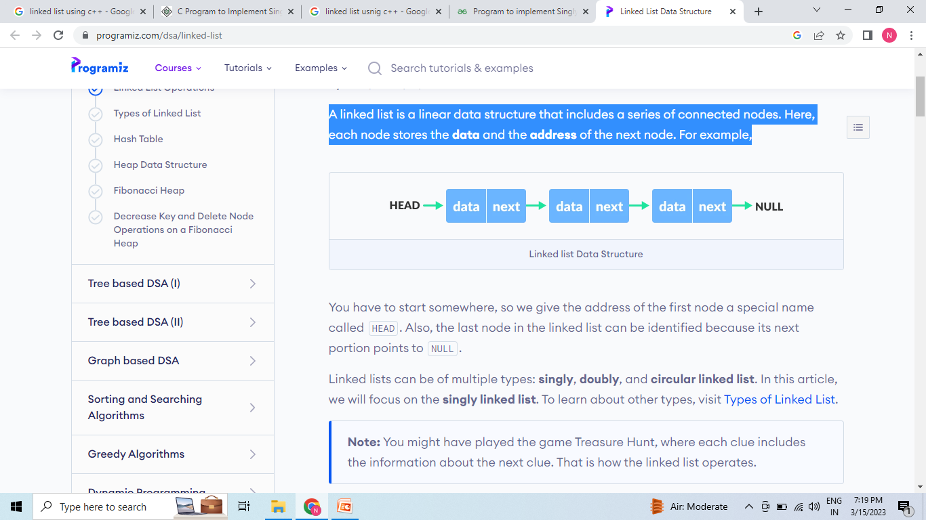
Linked List
A linked list is a linear data structure that includes a series of connected nodes. Here, each node stores the data and the address of the next node.

Slide 2
We give the address of the first node a special name called HEAD. Also, the last node in the linked list can be identified because its next portion points to NULL.
Linked lists can be of multiple types: singly, doubly, and circular linked list.

Slide 3
Each node of the linked list is represented. Each node consists:
A data item
An address of another node
We wrap both the data item and the next node reference in a struct as:
struct node
{
int data;
struct node *next;
};

Slide 4
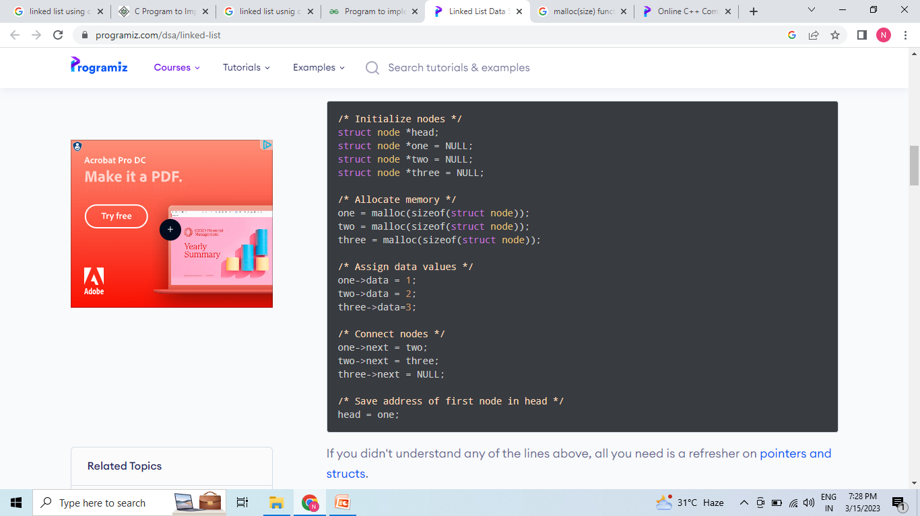

Slide 5
#include <iostream>
using namespace std;
// Creating a node
class Node {
public:
int value;
Node* next;
};
int main() {
Node* head;
Node* one = NULL;
Node* two = NULL;
Node* three = NULL;
// allocate 3 nodes in the heap
one = new Node();
two = new Node();
three = new Node();

Slide 6
// Assign value values
one->value = 1;
two->value = 2;
three->value = 3;
// Connect nodes
one->next = two;
two->next = three;
three->next = NULL;
// print the linked list value
head = one;
while (head != NULL) {
cout << head->value;
head = head->next;
}
}

Slide 7
Linked List Operation
The basic linked list operations are:-
Traversal - access each element of the linked list
Insertion - adds a new element to the linked list
Deletion - removes the existing elements
Search - find a node in the linked list
Sort - sort the nodes of the linked list

Slide 8
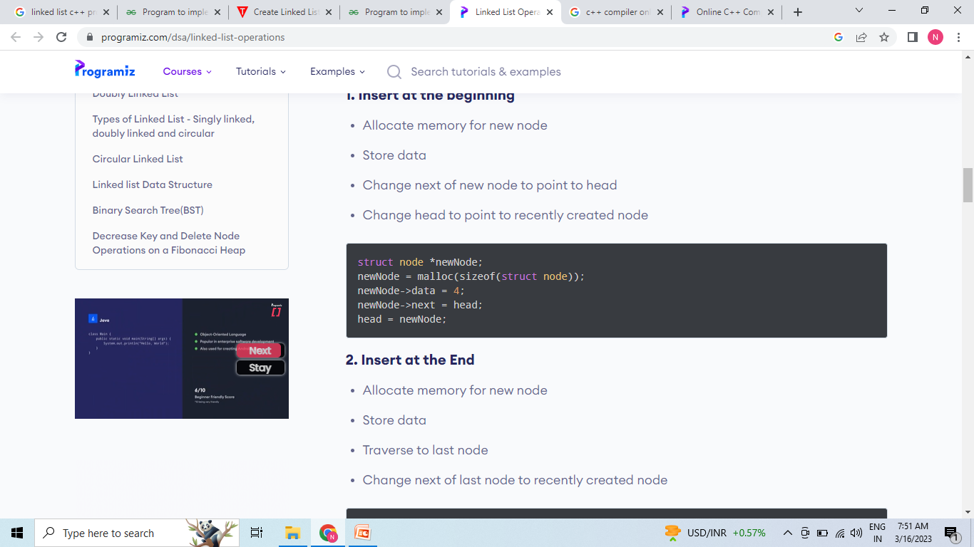
Insert at the beginning
Allocate memory for new node
Store data
Change next of new node to point to head
Change head to point to recently created node

Slide 9
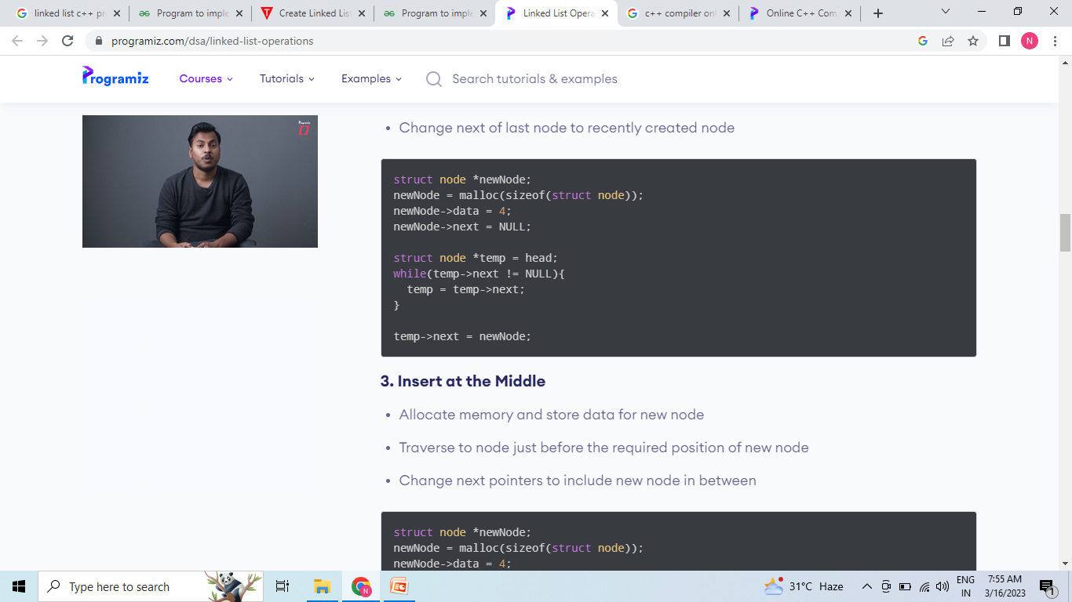
Insert at the End
Allocate memory for new node
Store data
Traverse to last node
Change next of last node to recently created node

Slide 10
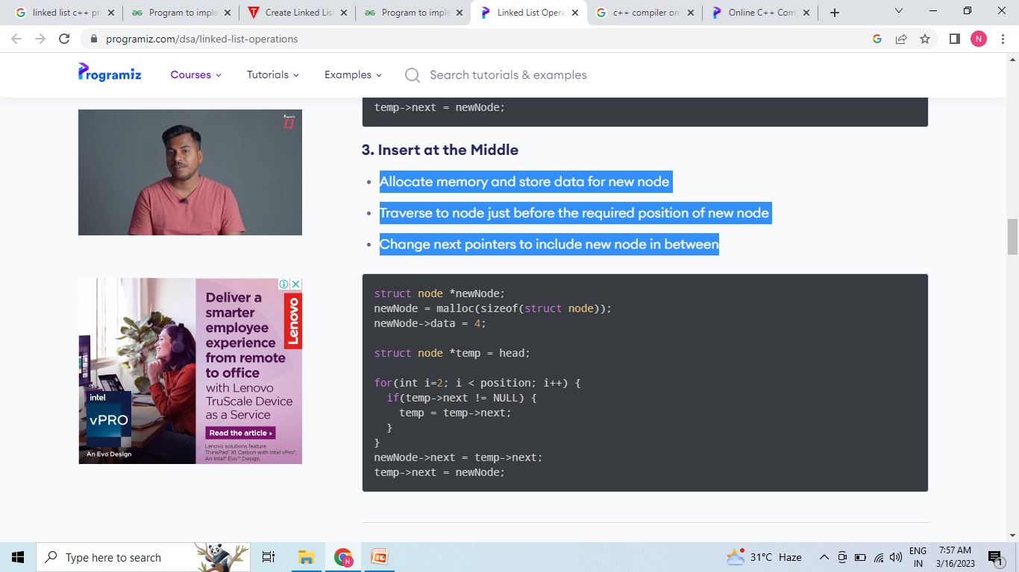
Insert at the middle
Allocate memory and store data for new node
Traverse to node just before the required position of new node
Change next pointers to include new node in between

Slide 11

Delete

Slide 12

Delete

Slide 13

Search an Element on a Linked List
Make head as the current node.
Run a loop until the current node is NULL because the last element points to NULL.
In each iteration, check if the key of the node is equal to item. If it the key matches the item, return true otherwise return false.

Slide 14
Sort Element
Make the head as the current node and create another node index for later use.
If head is null, return.
Else, run a loop till the last node (i.e. NULL).
In each iteration, follow the following step 5-6.
Store the next node of current in index.
Check if the data of the current node is greater than the next node. If it is greater, swap current and index.

Slide 15


Slide 16
Tree
Tree represents the nodes connected by edges. We will discuss binary tree or binary search tree specifically.
Binary Tree is a special datastructure used for data storage purposes. A binary tree has a special condition that each node can have a maximum of two children. A binary tree has the benefits of both an ordered array and a linked list as search is as quick as in a sorted array and insertion or deletion operation are as fast as in linked list.

Slide 17
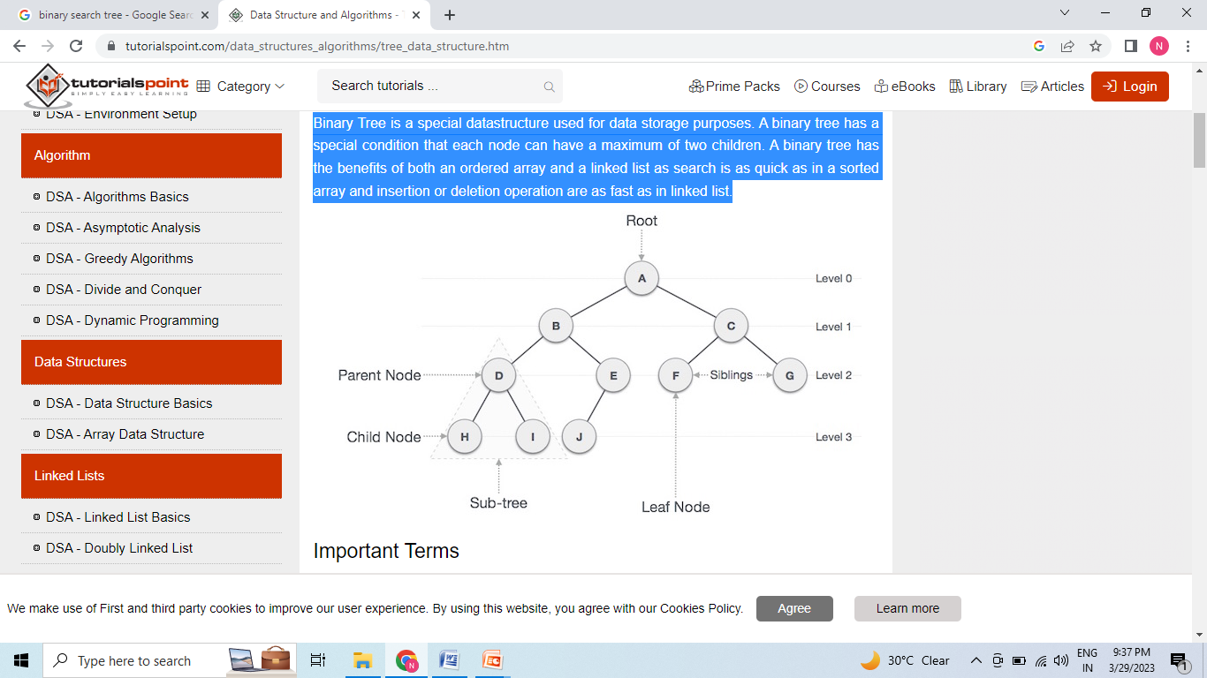

Slide 18
Path − Path refers to the sequence of nodes along the edges of a tree.
Root − The node at the top of the tree is called root. There is only one root per tree and one path from the root node to any node.
Parent − Any node except the root node has one edge upward to a node called parent.
Child − The node below a given node connected by its edge downward is called its child node.
Leaf − The node which does not have any child node is called the leaf node.
Subtree − Subtree represents the descendants of a node.

Slide 19
Visiting − Visiting refers to checking the value of a node when control is on the node.
Traversing − Traversing means passing through nodes in a specific order.
Levels − Level of a node represents the generation of a node. If the root node is at level 0, then its next child node is at level 1, its grandchild is at level 2, and so on.
keys − Key represents a value of a node based on which a search operation is to be carried out for a node.

Slide 20
Binary Search Tree
Binary Search Tree is a node-based binary tree data structure which has the following properties:
The left subtree of a node contains only nodes with keys lesser than the node’s key.
The right subtree of a node contains only nodes with keys greater than the node’s key.
The left and right subtree each must also be a binary search tree.

Slide 21
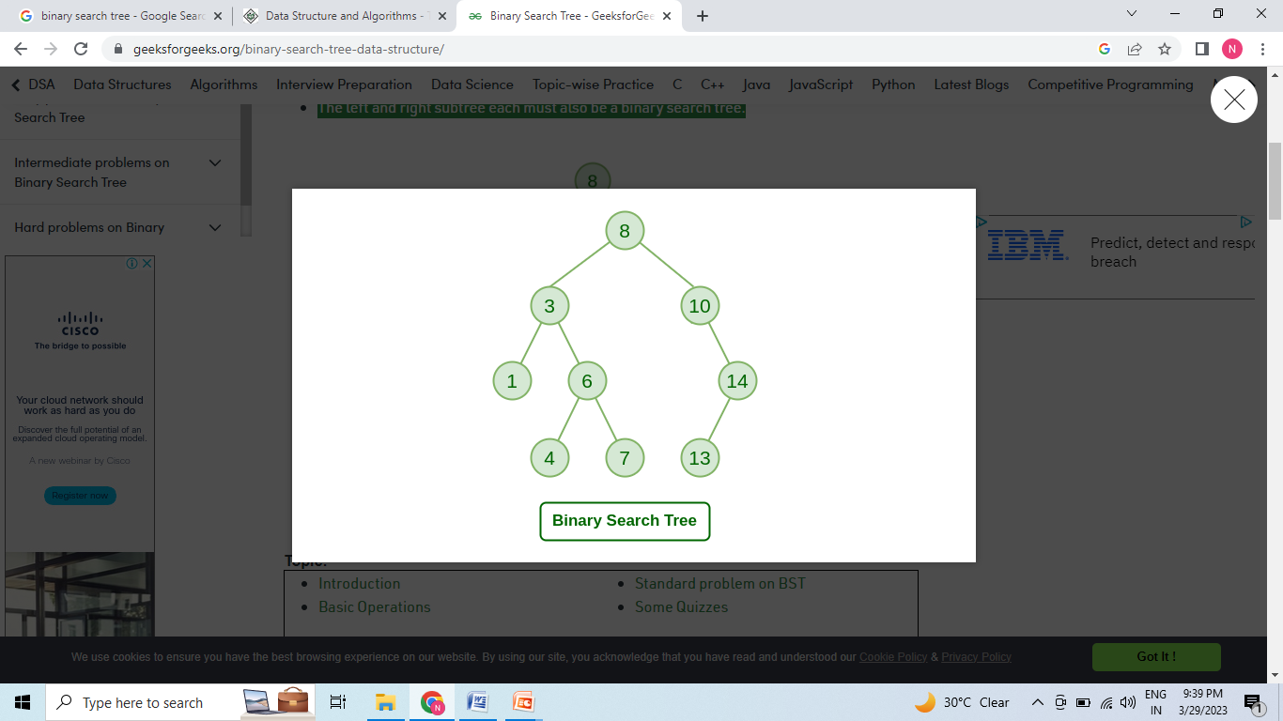

Slide 22
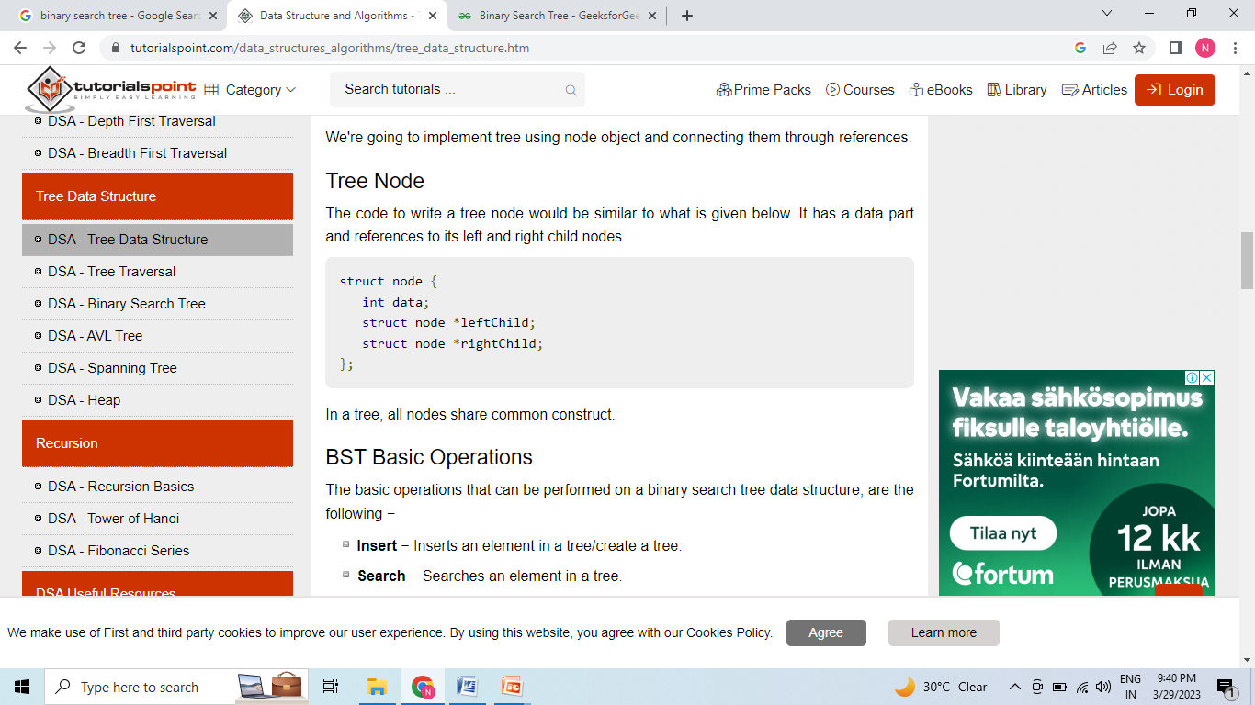
Tree Node

Slide 23
Basic Operations
Insert − Inserts an element in a tree/create a tree.
Search − Searches an element in a tree.
Preorder Traversal − Traverses a tree in a pre-order manner.
Inorder Traversal − Traverses a tree in an in-order manner.
Postorder Traversal − Traverses a tree in a post-order manner.

Slide 24
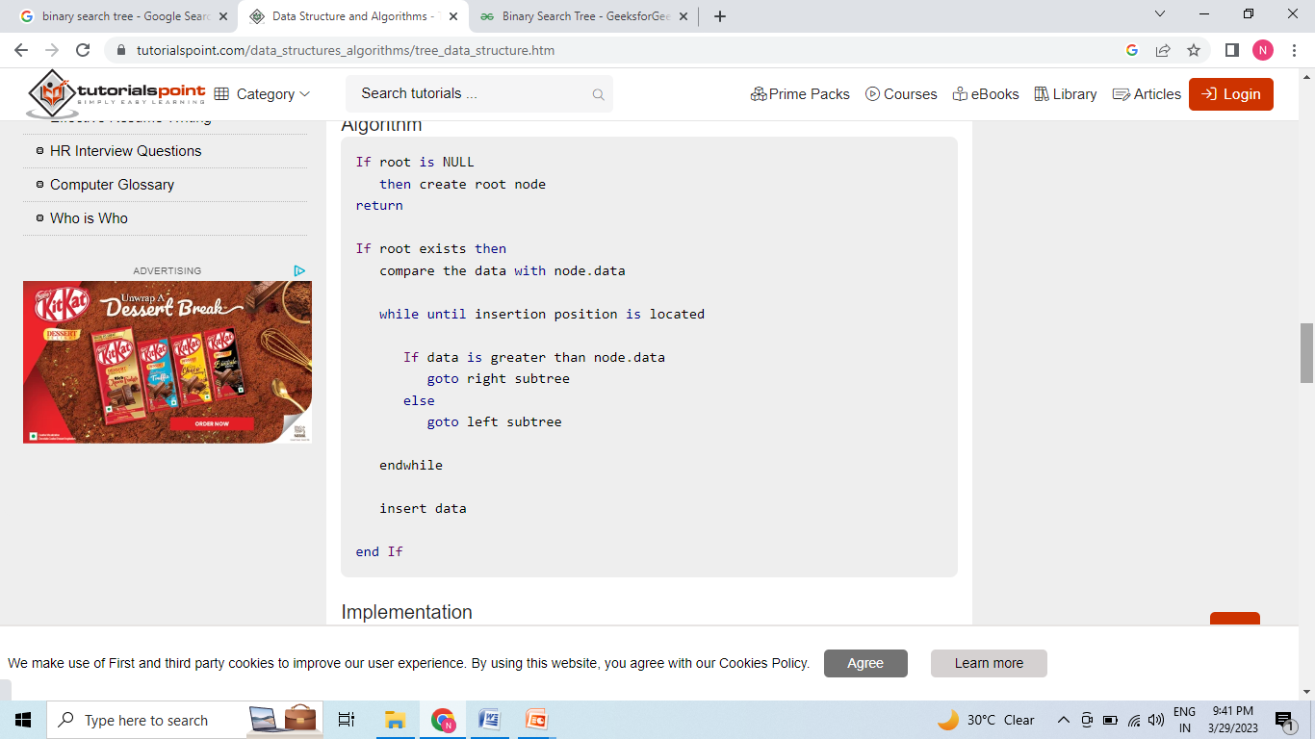
Insert

Slide 25
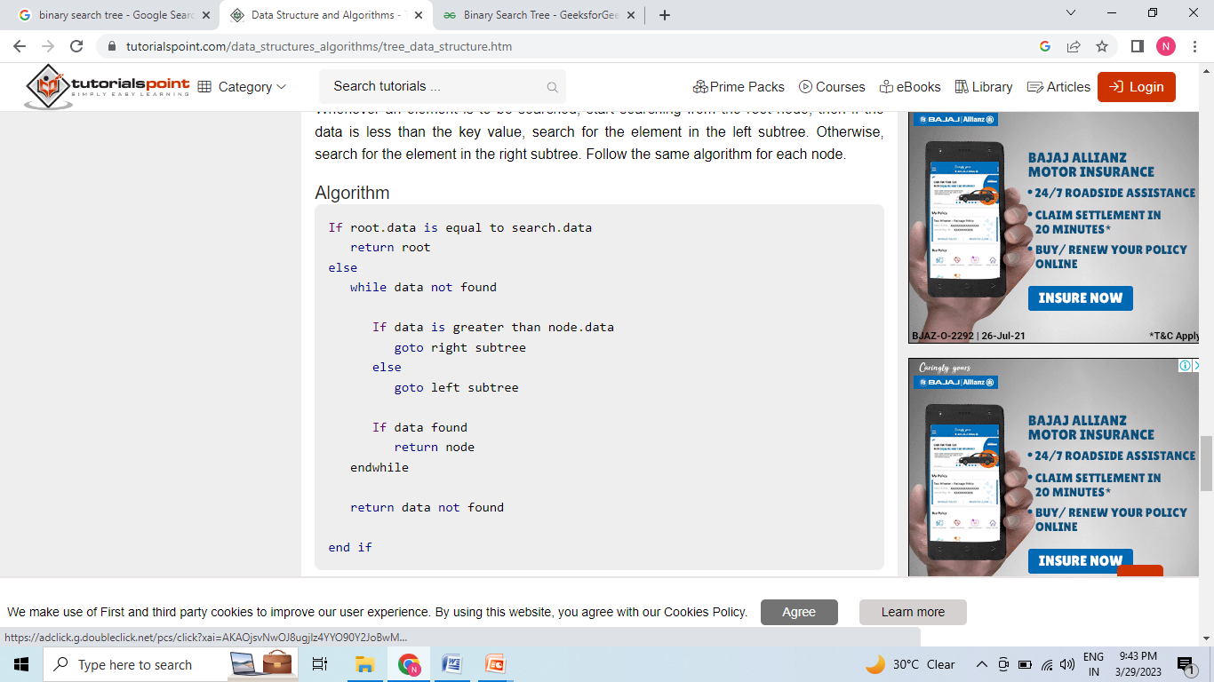
Search

Slide 26
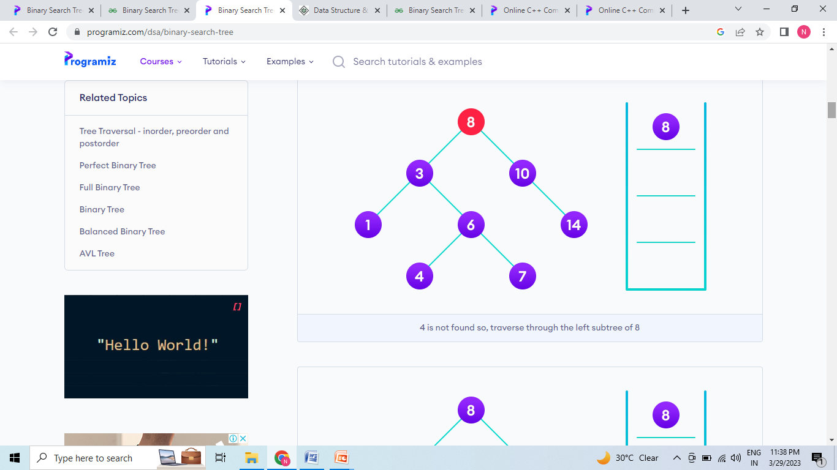

Slide 27
Traversing the Tree
Linear data structures like arrays, stacks, queues, and linked list have only one way to read the data. But a hierarchical data structure like a tree can be traversed in different ways.
According to this structure, every tree is a combination of
1.A node carrying data
2. Two subtrees

Slide 28
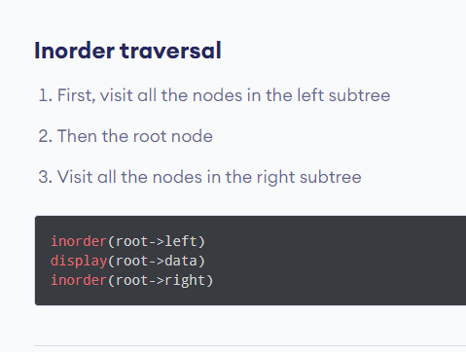

Slide 29
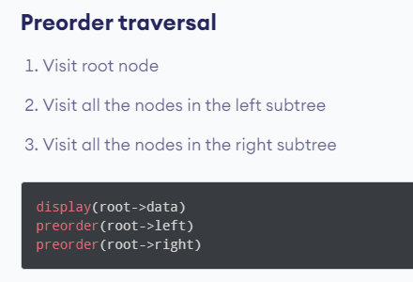

Slide 30


Slide 31
9
12
5
1
6

Slide 32
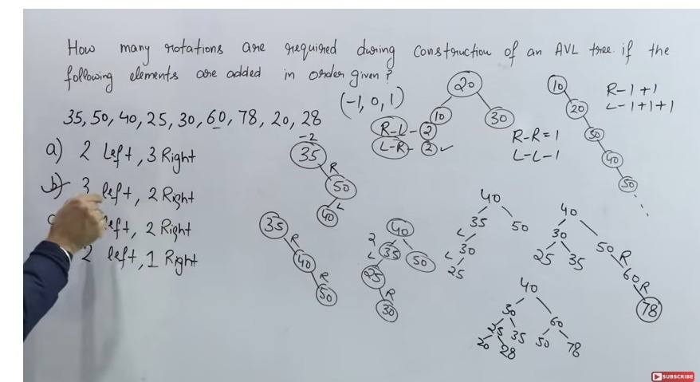
AVL tree

Slide 33
